Slide 1

HO CHI MINH UNIVERSITY OF TECHNOLOGY
FACULTY OF TRANSPORTATION ENGINEERING
DEPARTMENT OF AUTOMOTIVE AND ENGINE
CAPSTONE PROJECT
MODELING AND SIMULATION THE RESISTANCE TORQUE FOR SPECIFIC WHEEL ALIGNMENT IN THE ELECTRIC POWER STEERING SYSTEM BY USING MATLAB/SIMULINK AND ITS APPLICATION
STUDENT: Ho Binh Minh - ID: 1852169
INSTRUCTOR: Ph.D. Ngo Dac Viet
Ph.D. Tran Dang Long
DATE: 25/05/2023
TOPIC CODE: SVOISPLV-2022-KTGT-32

Slide 2
MODELING AND SIMULATION THE RESISTANCE TORQUE FOR SPECIFIC WHEEL ALIGNMENT IN THE ELECTRIC POWER STEERING SYSTEM BY USING MATLAB/SIMULINK AND ITS APPLICATION
CONTENTS
1
Introduction
2
Theoretical basis
3
Implementation process
4
Result and disscussion
5
Conclusion and future work
Ho Chi Minh University of Technology – 2023/05
1
Notes:
3. Mô tả bài toán (sử dụng mô phỏng)
4. Cases (các trường hợp)

Slide 3
MODELING AND SIMULATION THE RESISTANCE TORQUE FOR SPECIFIC WHEEL ALIGNMENT IN THE ELECTRIC POWER STEERING SYSTEM BY USING MATLAB/SIMULINK AND ITS APPLICATION
CONTENTS
1
Introduction
1.1
Thesis objectives & limitations
2
Theoretical basis
1.2
Working conditions & Technical requirements
3
Implementation process
1.3
V model
4
Result and discussion
5
Conclusion and future work
Ho Chi Minh University of Technology – 2023/01
2
Notes:
3. Mô tả bài toán (sử dụng mô phỏng)
4. Cases (các trường hợp)

Slide 4
1. INTRODUCTION
1.1 Thesis objectives & limitations
Thesis’s objectives: Modeling and simulation the resistance torque for specific wheel alignment in the Electric Power Steering system by using Matlab/Simulink and its application.
Find out how wheel alignment can affect the resistance torque in the steering mechanism especially in the EPS system.
Build the complete model of the resistance torque between the tire forces and road.
Idea:
Using Matlab/Simulink environment to simulate and verify the response of the system.
Hypothesis:
The model is developed by assuming that the wheels are in contact with the road surface.
Limitations:
The tire turns right only.
Longitudinal force, lateral force, rolling resistance force, normal force and no more internal and external force.
Ho Chi Minh University of Technology – 2023/01
3

Slide 5
1. INTRODUCTION
1.2 Working conditions and technical requirements
Working conditions:
- Continuously change to adapt to variable driving conditions.
Technical requirements:
- Working normally in above conditions.
- Measuring resistance torque range: The error within the allowable range.
Ho Chi Minh University of Technology – 2023/01
4

Slide 6
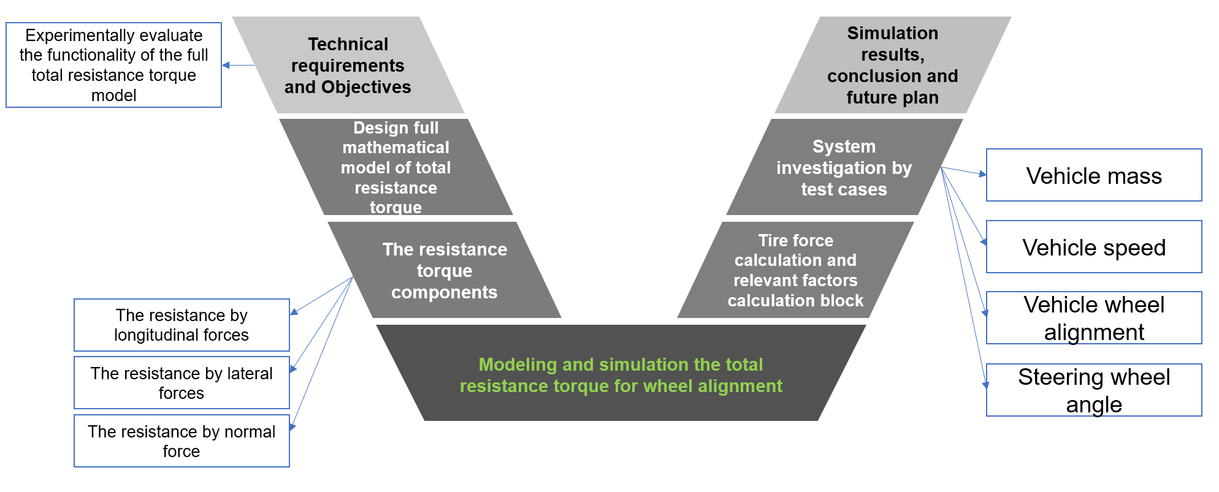
1. INTRODUCTION
1.3 V model
Ho Chi Minh University of Technology – 2023/01
4

Slide 7
MODELING AND SIMULATION THE RESISTANCE TORQUE FOR SPECIFIC WHEEL ALIGNMENT IN THE ELECTRIC POWER STEERING SYSTEM BY USING MATLAB/SIMULINK AND ITS APPLICATION
CONTENTS
1
Introduction
2.1
Wheel alignment
2
Theoretical basis
2.2
Tire force equations
3
Implementation process
2.3
Total resistance torque equations
4
Result and disscussion
5
Conclusion and future work
Ho Chi Minh University of Technology – 2023/01
5

Slide 8
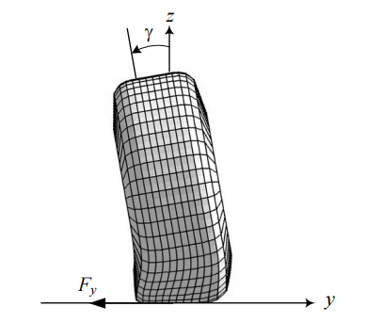
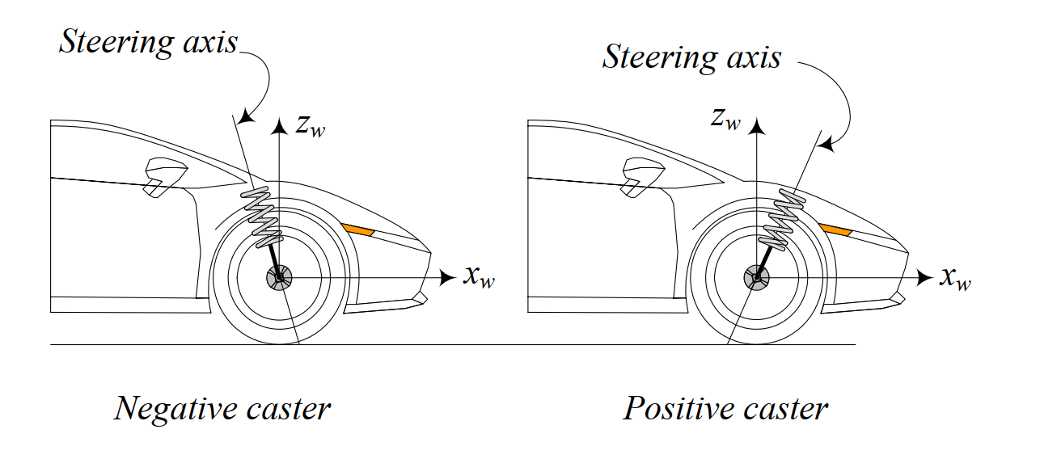
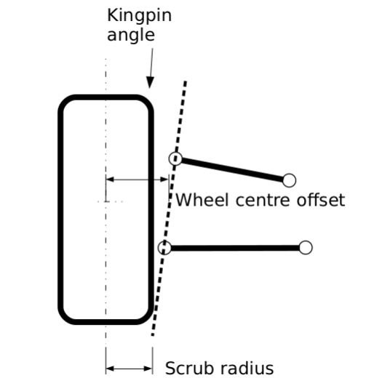
2. THEORETICAL BASIS
2.1 Wheel alignment
Figure: Overall in Caster angle
Figure: Kingpin angle and its scrub radius
Figure: Camber angle at front view
Caster angle is the angular displacement of the steering axis from the vertical axis of a steered wheel.
Kingpin angle is a measure of the angle of the suspension steer axis relative to vertical at front view.
Camber angle is is the angle between the vertical axis of a wheel and the vertical axis of the vehicle when viewed from the front or rear
Ho Chi Minh University of Technology – 2023/01
6

Slide 9
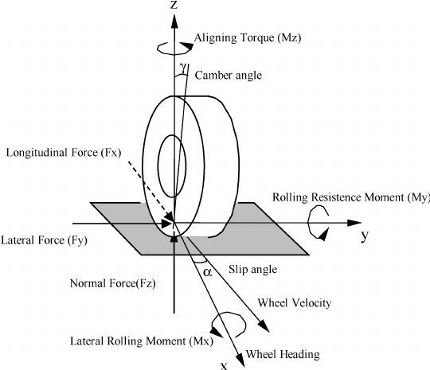
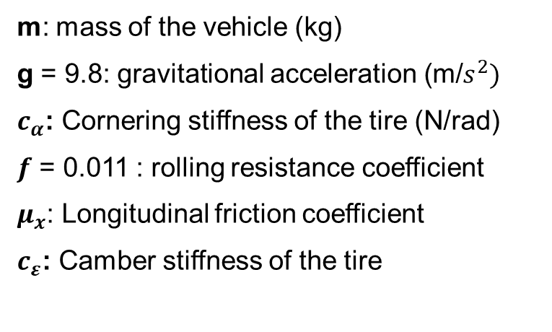




2. THEORETICAL BASIS
2.2 Tire force equations
$F_{z}=\frac{1}{2}.m.g.\frac{a_{2}}{l}$
$F_{y}=C_{α}.α$ + $C_{ε}.ε$
$F_{rolling}= m.g.f$
Rolling resistance force (Fr)
$F_{x}=μ_{x}{.F}_{z}$
m: mass of the vehicle (kg)
g = 9.8: gravitational acceleration (m/$s^{2})$
$c_{α}$: Cornering stiffness of the tire (N/rad)
$f$ = 0.011 : rolling resistance coefficient
$μ_{x}$: Longitudinal friction coefficient
$c_{ε}$: Camber stiffness of the tire
Figure: Overall tire forces and Kingpin angle
Ho Chi Minh University of Technology – 2023/01
7

Slide 10
2. THEORETICAL BASIS
2.3 Total resistance torque equations
Input
Moment arm
Input
Total resistance torque
Input
Input
Applied forces
Input
Operation flow
Ho Chi Minh University of Technology – 2023/01
8

Slide 11
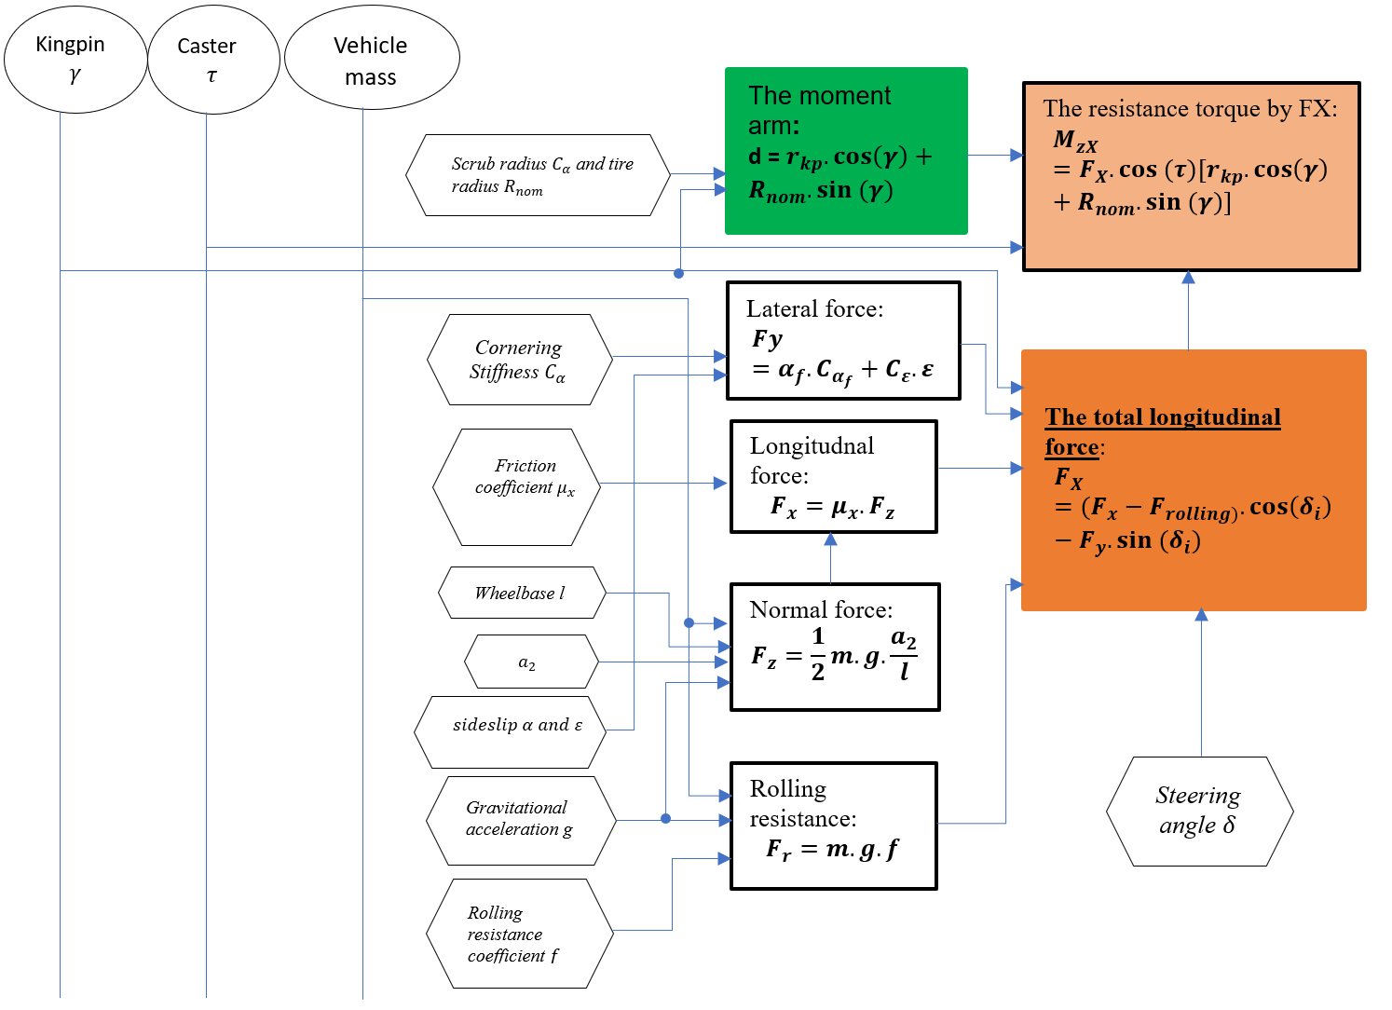
2. THEORETICAL BASIS
2.3 Total resistance torque equations
Ho Chi Minh University of Technology – 2023/01
9

Slide 12
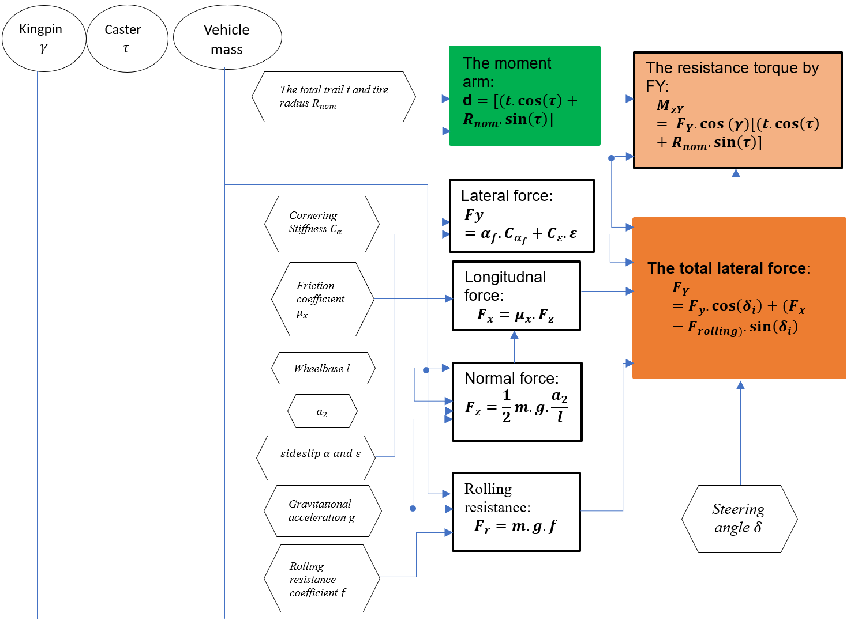
2. THEORETICAL BASIS
2.3 Total resistance torque equations
Ho Chi Minh University of Technology – 2023/01
10

Slide 13
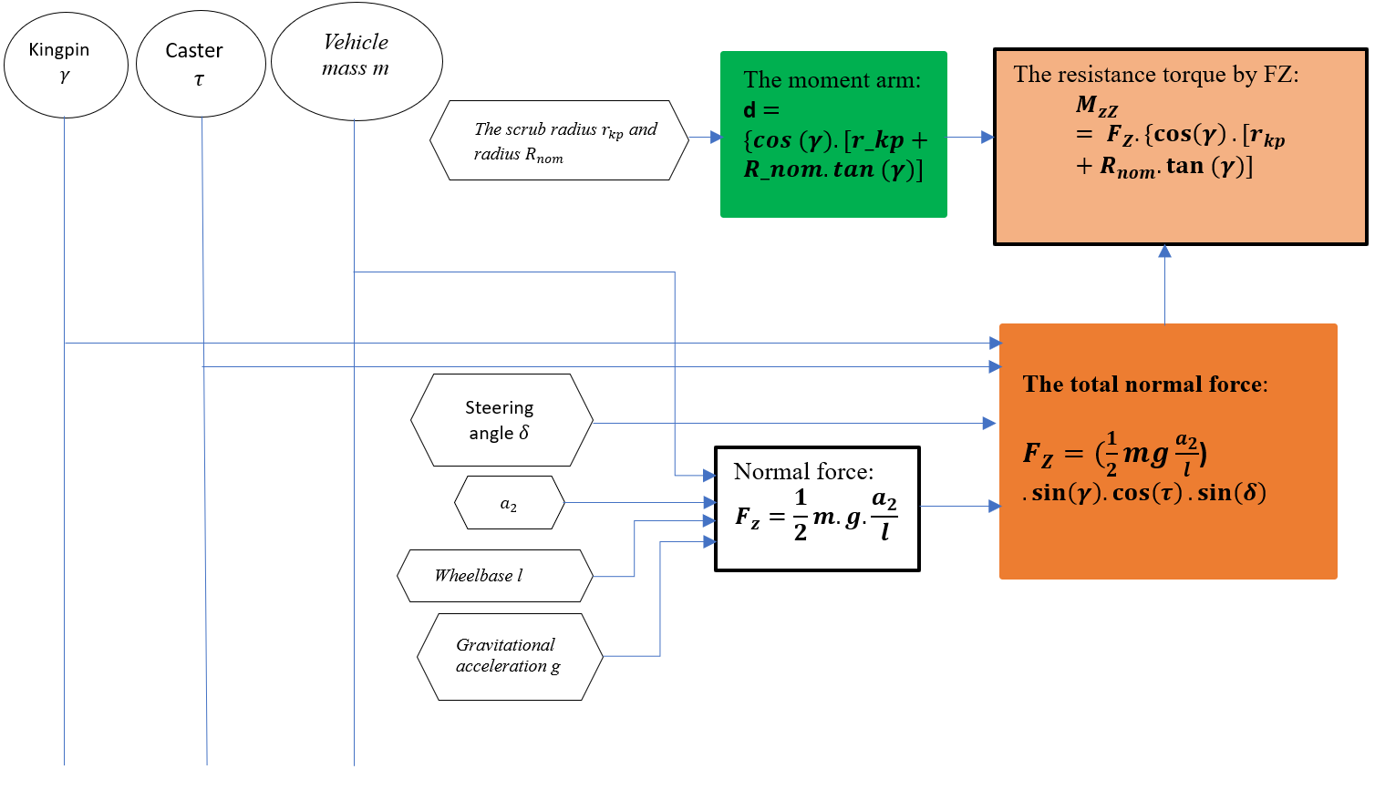
2. THEORETICAL BASIS
2.3 Total resistance torque equations
Ho Chi Minh University of Technology – 2023/01
11

Slide 14
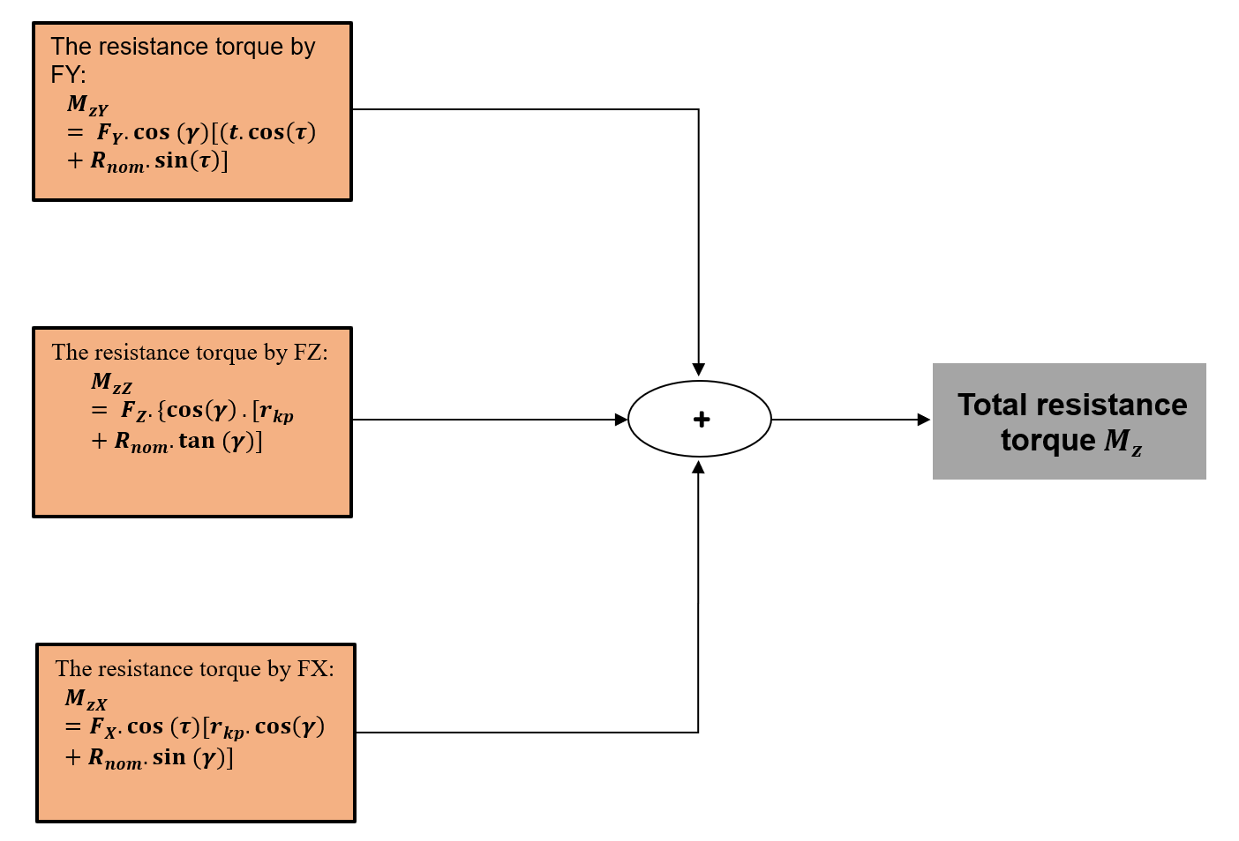
2. THEORETICAL BASIS
2.3 Total resistance torque equations
Ho Chi Minh University of Technology – 2023/01
12

Slide 15
MODELING AND SIMULATION THE RESISTANCE TORQUE FOR SPECIFIC WHEEL ALIGNMENT IN THE ELECTRIC POWER STEERING SYSTEM BY USING MATLAB/SIMULINK AND ITS APPLICATION
CONTENTS
1
Introduction
3.1
Modeling the total resistance torque by longitudinal forces FX
2
Theoretical basis
3
3.2
Modeling the total resistance torque by lateral forces FY
Implementation process
4
Result and disscussion
3.3
Modeling the total resistance torque by normal force FZ
5
Conclusion and future work
Ho Chi Minh University of Technology – 2023/01
13
Notes:
3. Mô tả bài toán (sử dụng mô phỏng)
4. Cases (các trường hợp)

Slide 16
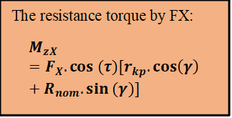
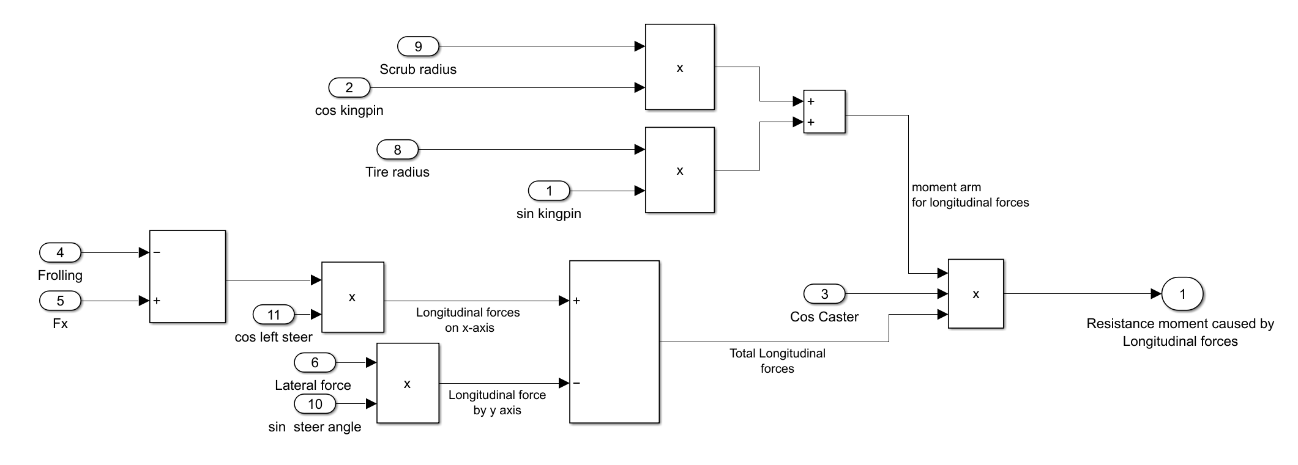
3. IMPLEMENTATION PROCESS
3.1 Modeling the total resistance torque by longitudinal forces FX
Moment arm
Total applied force
Ho Chi Minh University of Technology – 2023/01
14

Slide 17
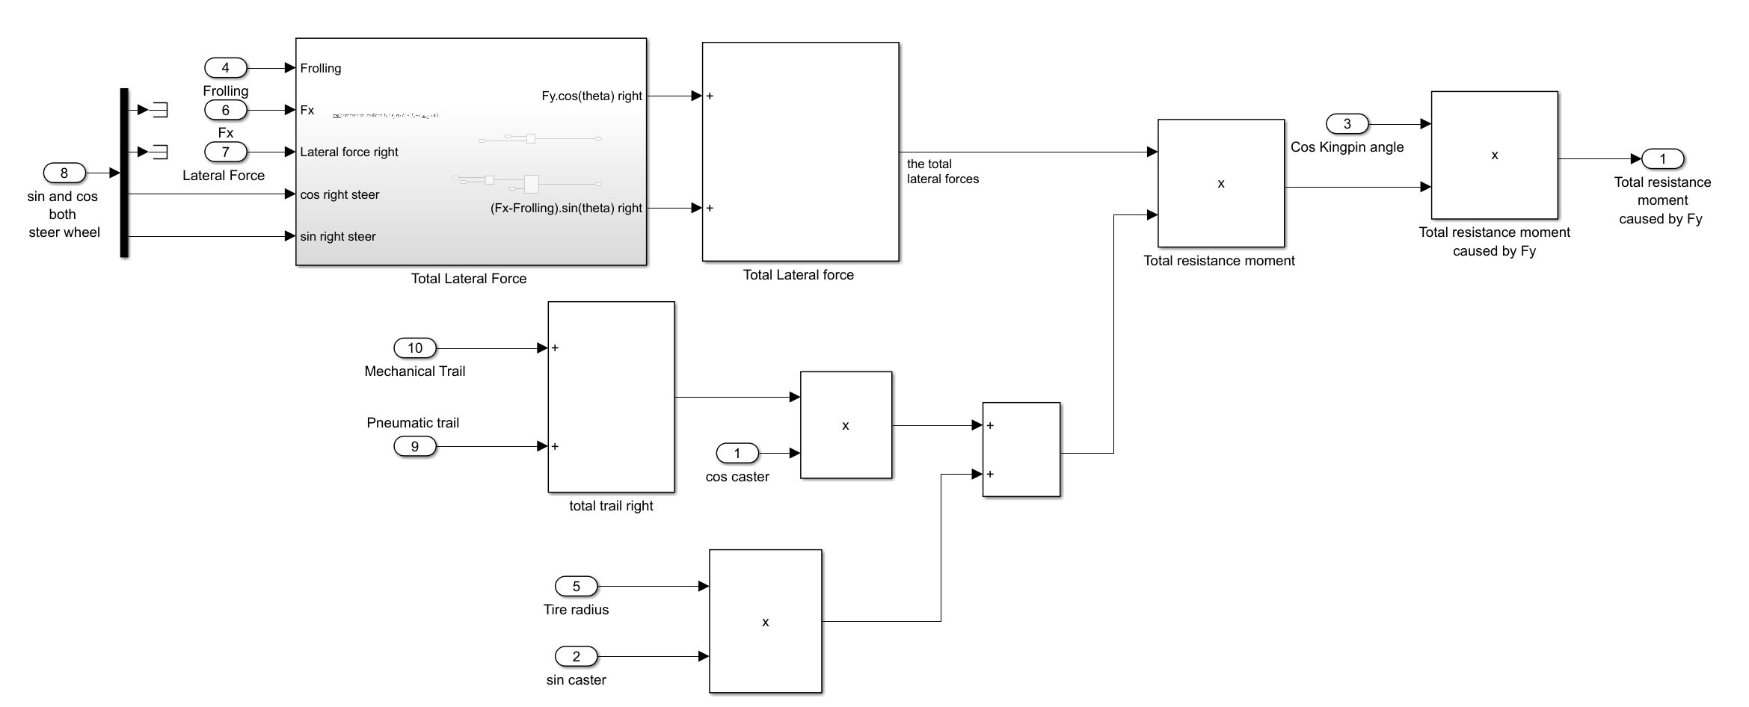
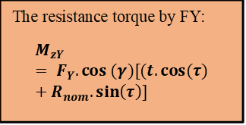
3. IMPLEMENTATION PROCESS
3.2 Modeling the total resistance torque by lateral forces FY
Moment arm
Total applied force
Ho Chi Minh University of Technology – 2023/01
15

Slide 18
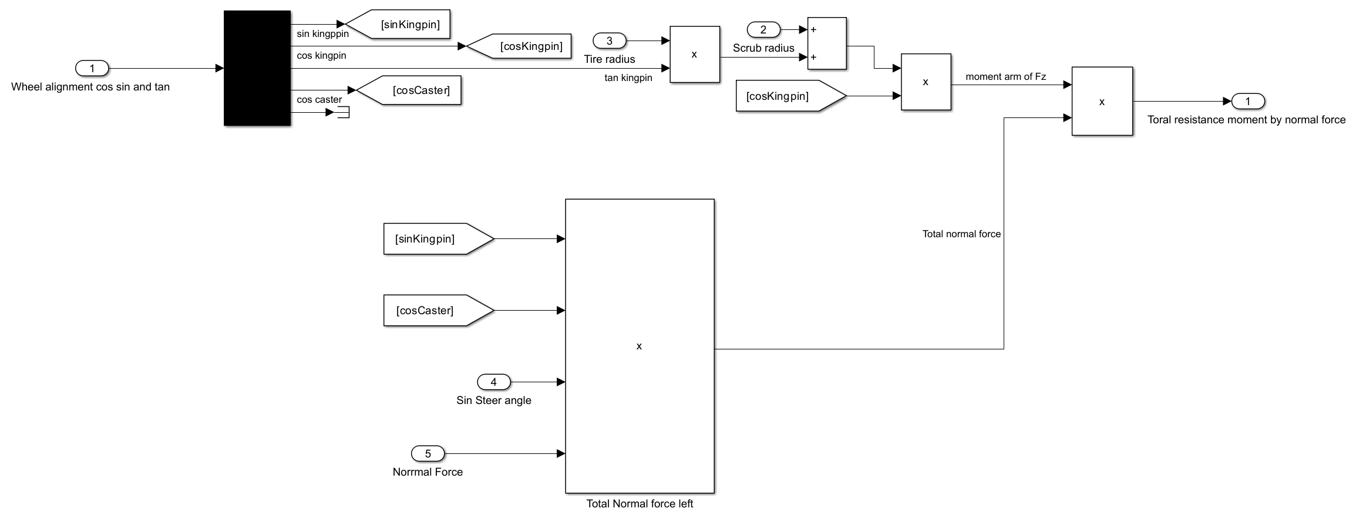
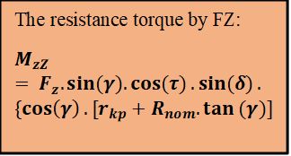
3. IMPLEMENTATION PROCESS
3.3 Modeling the total resistance torque by normal forces FZ
Moment arm
Total applied force
Ho Chi Minh University of Technology – 2023/01
16

Slide 19
MODELING AND SIMULATION THE RESISTANCE TORQUE FOR SPECIFIC WHEEL ALIGNMENT IN THE ELECTRIC POWER STEERING SYSTEM BY USING MATLAB/SIMULINK AND ITS APPLICATION
CONTENTS
1
Introduction
4.1
Vehicle mass
4.2
Vehicle velocity
2
Key problems
3
4.3
Wheel alignment
Implementation process
4.4
Steering wheel angle
4
Result and disscussion
5
Conclusion and future work
Ho Chi Minh University of Technology – 2023/01
17
Notes:
3. Mô tả bài toán (sử dụng mô phỏng)
4. Cases (các trường hợp)

Slide 20
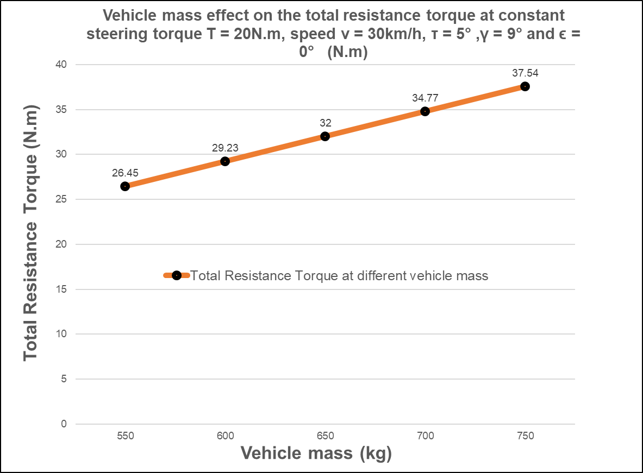
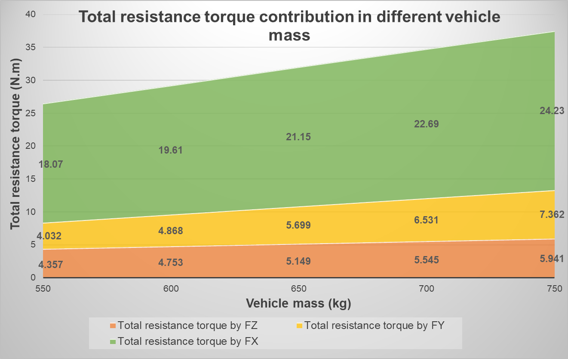
4. Result and disscussion
4.1 Vehicle mass
Total resistance torque increases when vehicle mass increases.
Total resistance torque by Fz increases slowly when vehicle mass increases.
Total resistance torque by FY and FX increase quickly when vehicle mass increases.
Vehicle mass has strong influence on total resistance torque
Ho Chi Minh University of Technology – 2023/01
18

Slide 21
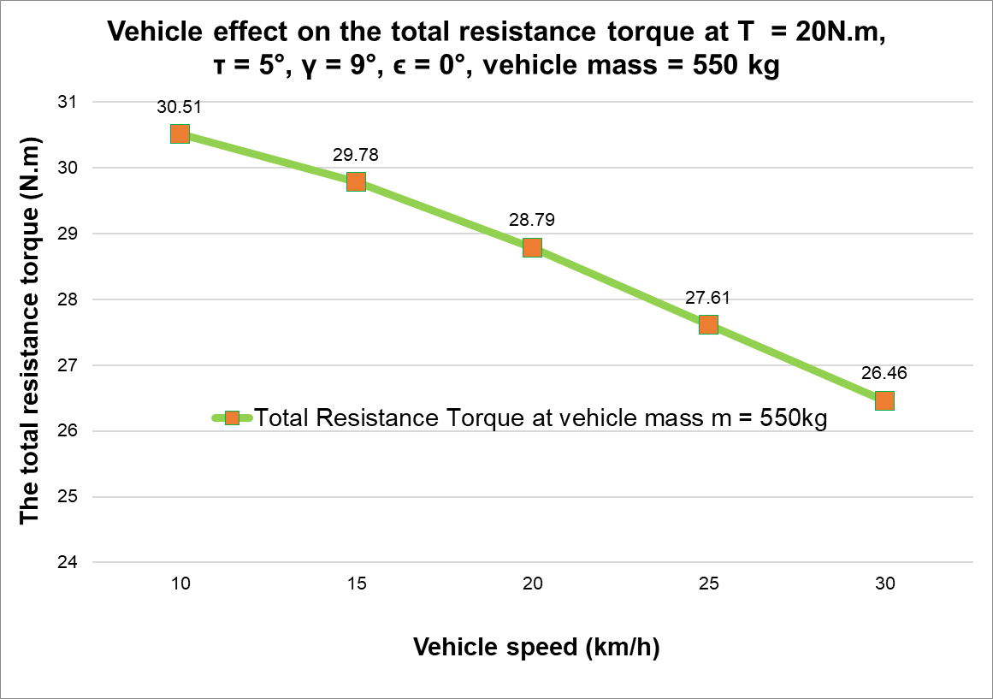
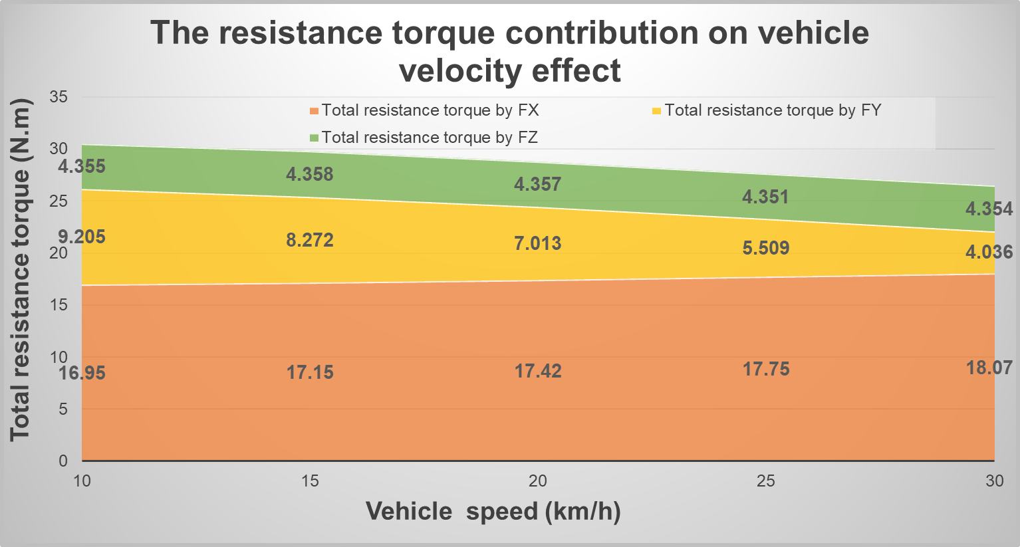
4. Result and disscussion
4.2 Vehicle velocity
Total resistance torque decreases when vehicle speed increases
Decrease quickly at low speed and gradually higher speed range
Total resistance torque by Fz is stable when vehicle speed increases
Total resistance torque by FX gradually increases while resistance torque by FY rapidly decreases when vehicle vehicle increases
Vehicle velocity has influence on total resistance torque
Ho Chi Minh University of Technology – 2023/01
19

Slide 22
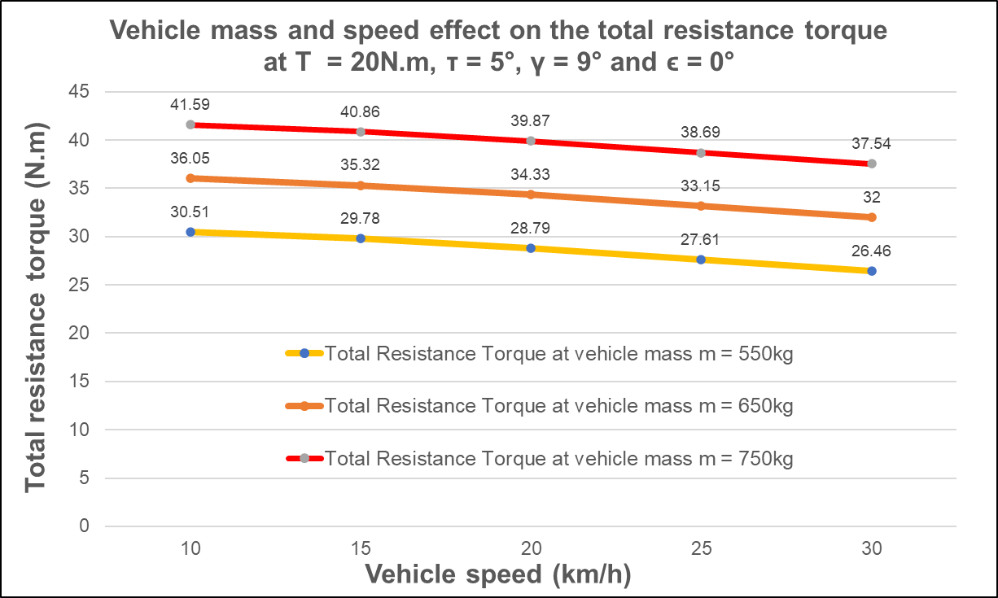
4. Result and disscussion
4.1 + 4.2: Vehicle mass and vehicle speed
Total resistance torque also decrease when changing both vehicle mass and vehicle speed
Ho Chi Minh University of Technology – 2023/01
20

Slide 23
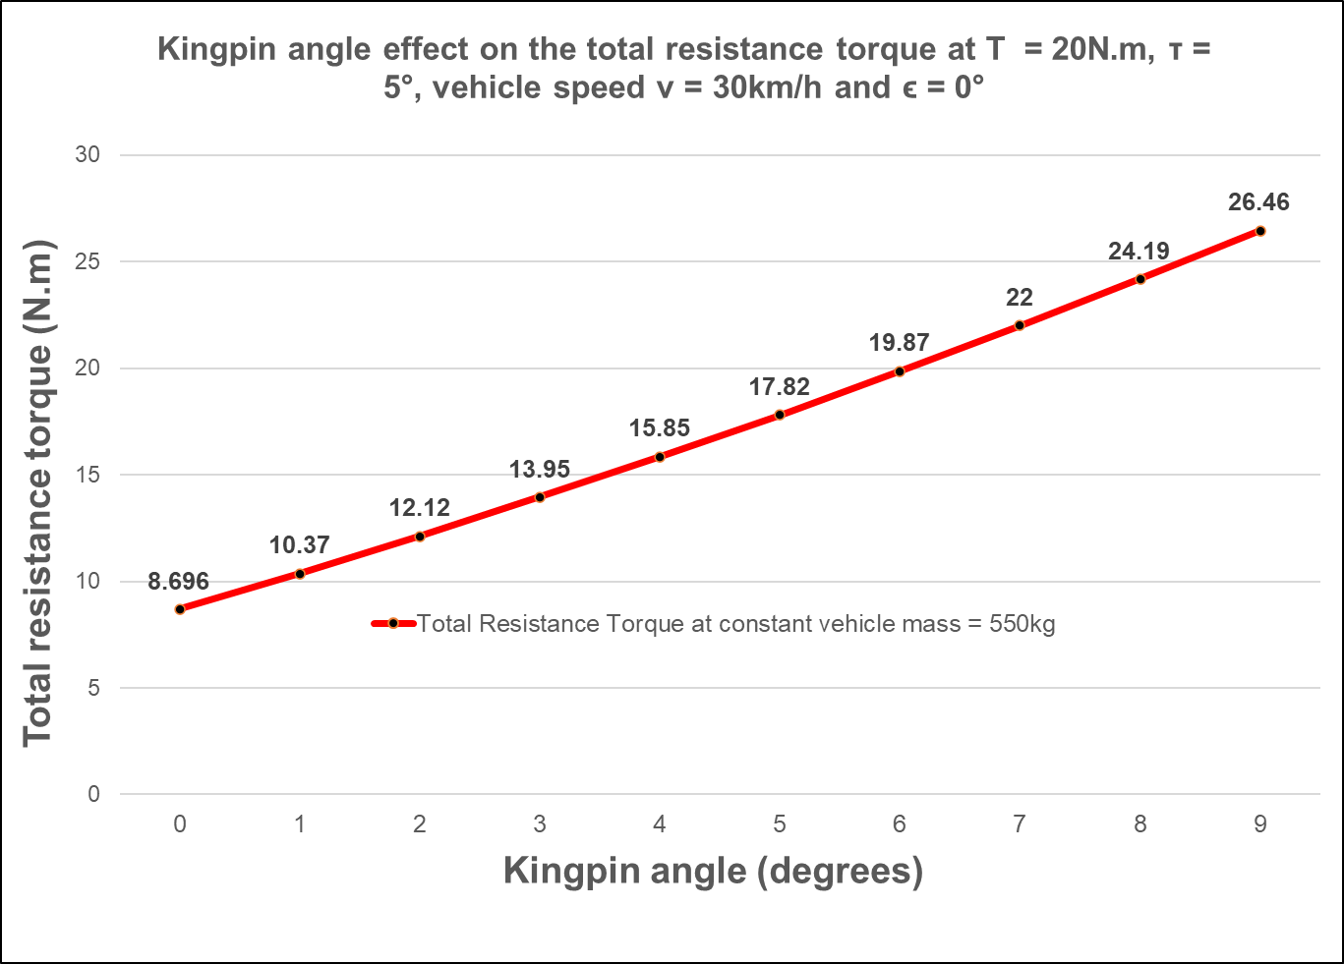
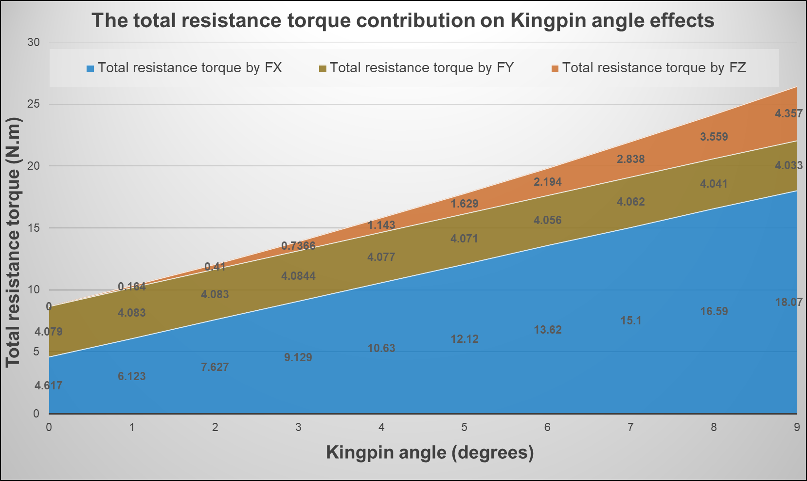
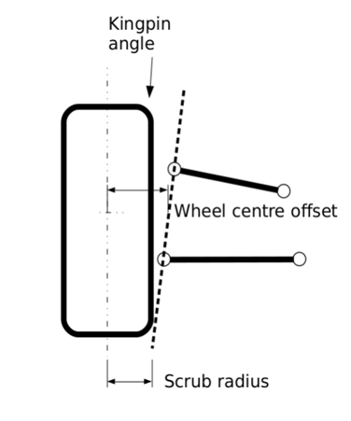
4. Result and disscussion
4.3: Wheel alignment
Total resistance torque increases when Kingpin angle increases
Total resistance torque caused FY is almost stable when Kingpin angle increases.
Total resistance torque caused FZ and FX rapidly increases when Kingpin angle increases.
Changing in Kingpin vehicle wheel alignment
Kingpin angle has strong influence on total resistance torque
Ho Chi Minh University of Technology – 2023/01
21

Slide 24
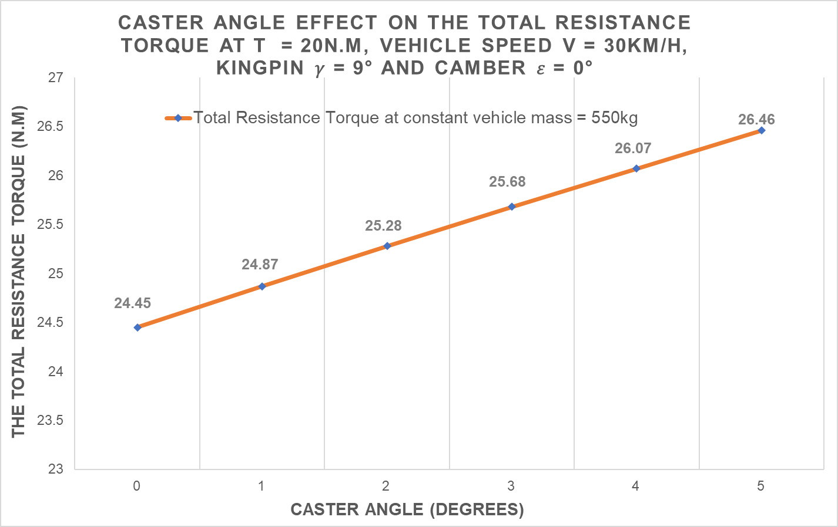
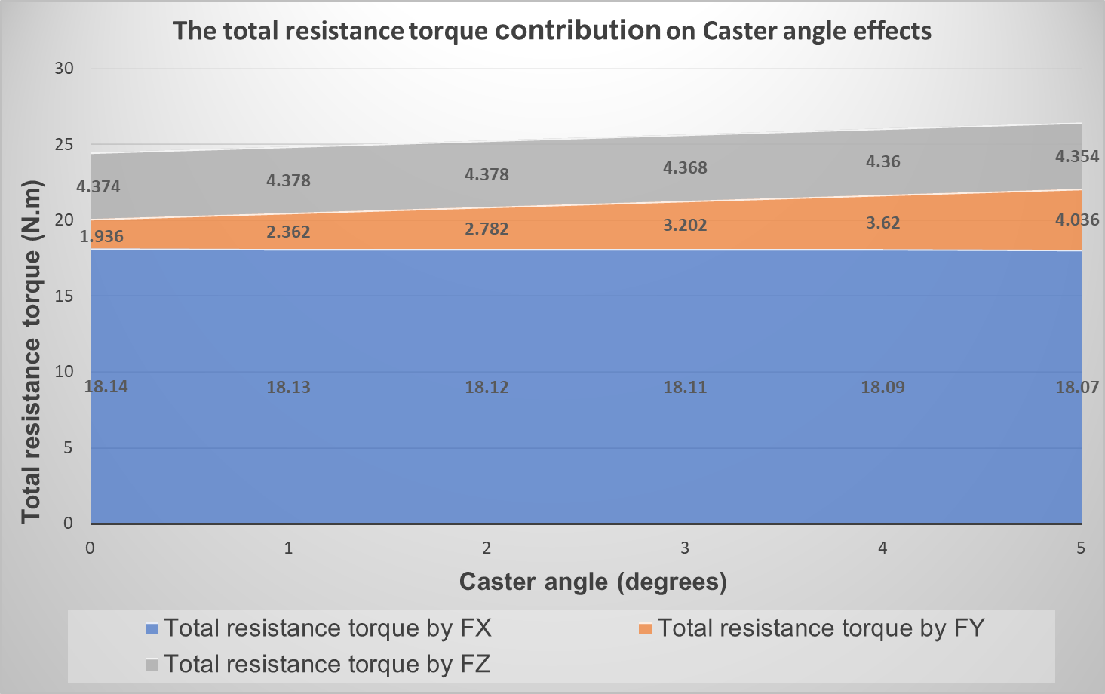
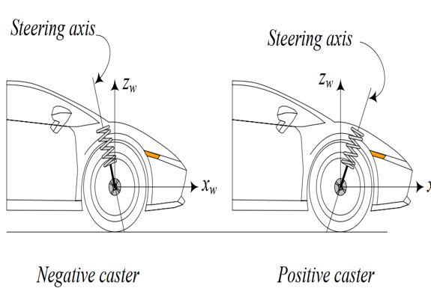
4. Result and disscussion
4.3: Wheel alignment
Total resistance torque increases when Caster angle increases
Total resistance torque caused FX and FZ are almost stable when Caster angle increases.
Total resistance torque caused FY increase when Caster angle increases.
Changing in Caster vehicle wheel alignment
Caster angle has slight effect on total resistance torque
Ho Chi Minh University of Technology – 2023/01
22

Slide 25
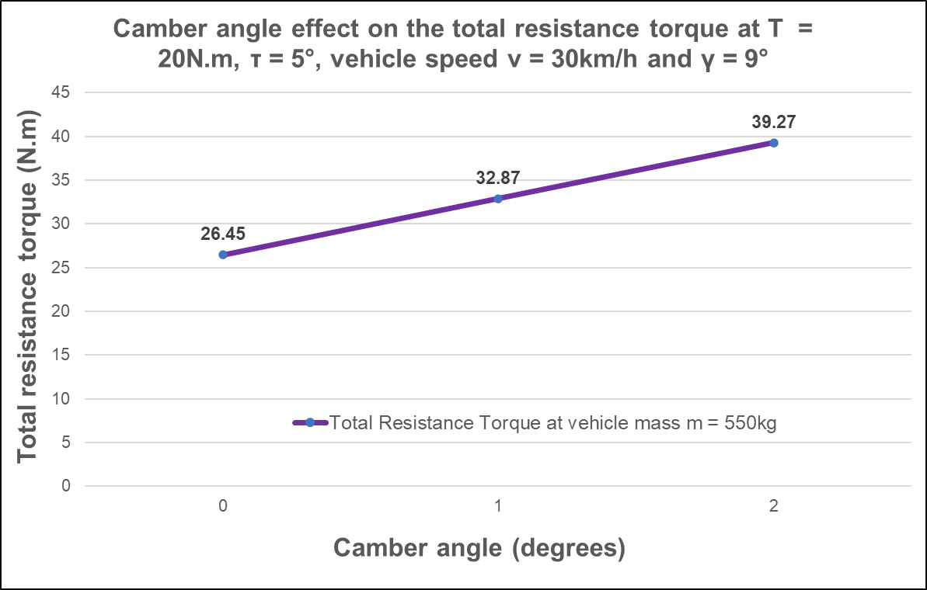
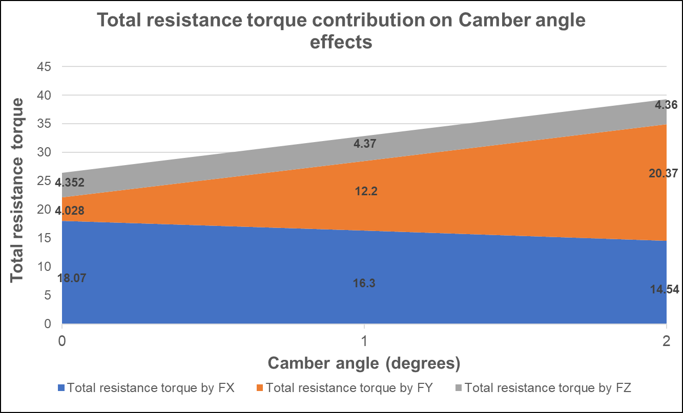
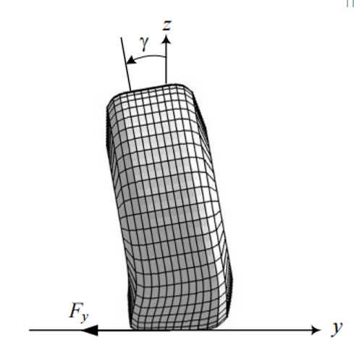
4. Result and disscussion
4.3: Wheel alignment
Total resistance torque increases when Camber angle increases.
Total resistance torque caused FZ is constant when Camber angle increases.
While total resistance torque caused FY rapidly increases, the total resistance torque caused by FX quickly decreases when Camber angle increases.
Changing in Camber vehicle wheel alignment
Camber angle has impact on total resistance torque
Ho Chi Minh University of Technology – 2023/01
23

Slide 26
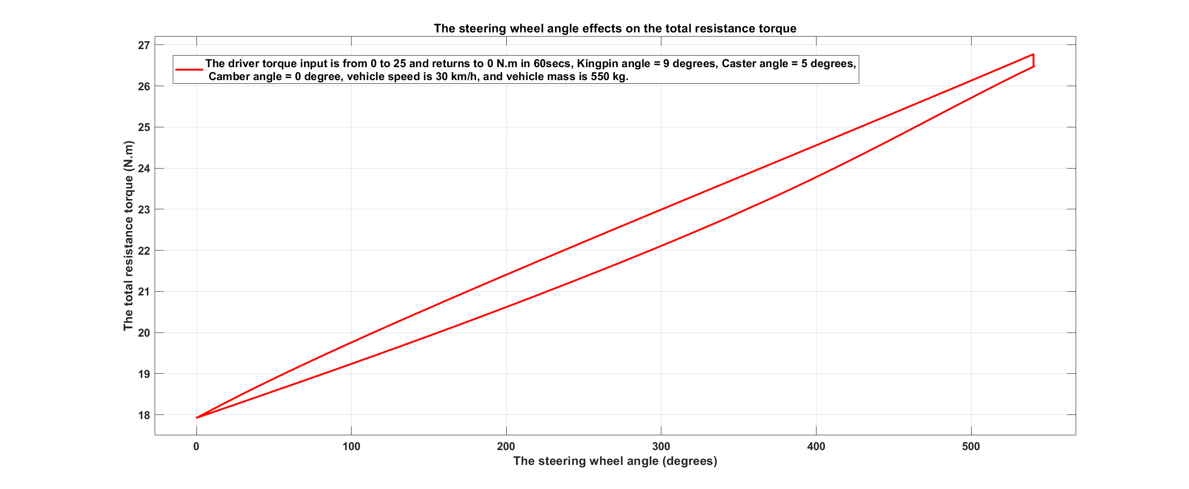
4. Result and disscussion
4.4 Steering wheel angle
Increase steering wheel angle, increase the total resistance torque
Vehicle steering wheel angle has huge impact on total resistance torque
Ho Chi Minh University of Technology – 2023/01
24

Slide 27
4. Result and disscussion
4.4 Steering wheel angle
Increase steering wheel angle, increase the total resistance torque
Vehicle steering wheel angle has huge impact on total resistance torque
Ho Chi Minh University of Technology – 2023/01
24

Slide 28
MODELING AND SIMULATION THE RESISTANCE TORQUE FOR SPECIFIC WHEEL ALIGNMENT IN THE ELECTRIC POWER STEERING SYSTEM BY USING MATLAB/SIMULINK AND ITS APPLICATION
CONTENTS
1
Introduction
2
Theoretical basis
3
Implementation process
4
Result and disscussion
5
Conclusion and future work
Ho Chi Minh University of Technology – 2023/01
25
Notes:
3. Mô tả bài toán (sử dụng mô phỏng)
4. Cases (các trường hợp)

Slide 29
5. CONCLUSION & FUTURE WORK
CONCLUSION
It is recommended to develop this steering mechanism model and go further to simulate different situations by assisting simulators such as Matlab/Simulink based on all relevant theories mentioned in this Capstone project
FUTURE WORKS
All the steering resistance torque conveys are clearly mentioned in this Capstone project. Moreover, a total steering resistance torque model of a power steering system is built exactly by applying the above knowledge: numerical equations and relevant factors. It can also be used for the design of other power steering systems, thanks to the resistance torque model to calculate the appropriate assist torque in different driving conditions.
The main conclusion obtained in this Capstone project is how the wheel alignment especially the Caster angle, Kingpin angle, and Camber angle affects to the resistance moment.
Ho Chi Minh University of Technology – 2023/01
26

Slide 30
References
Jazar, R. N. (2017). Vehicle Dynamics: Theory and Application (3rd ed. 2017). Springer.
Lenzo, B. (2021). Vehicle Dynamics: Fundamentals and Ultimate Trends (CISM International Centre for Mechanical Sciences, 603) (1st ed. 2022). Springer.
Cossalter, V. (2006). Motorcycle Dynamics (2nd ed.). Lulu.com.
Reimpell, J., Stoll, H., Betzler, J. W., & Engineers, S. O. A. (2022). The Automotive Chassis: Engineering Principles (2nd ed.). Society of Automotive Engineers.
American Association of State Highway and Transportation Officials. (2022). A Policy on Geometric Design of Highways and Streets 2011 (6th ed.). Amer Assn of State Hwy.
Wikipedia contributors. (2022, September 13). Vehicle dynamics. Wikipedia. https://en.wikipedia.org/wiki/Vehicle_dynamics
Pauwelussen, J. (2014). Essentials of Vehicle Dynamics (1st ed.). Butterworth-Heinemann.
Hu, C. H. (2008). Modeling and Simulation of Automotive Electric Power Steering System. 2008 Second International Symposium on Intelligent Information Technology Application. https://doi.org/10.1109/iita.2008.51
Ho Chi Minh University of Technology – 2023/01
27

